Slide 1
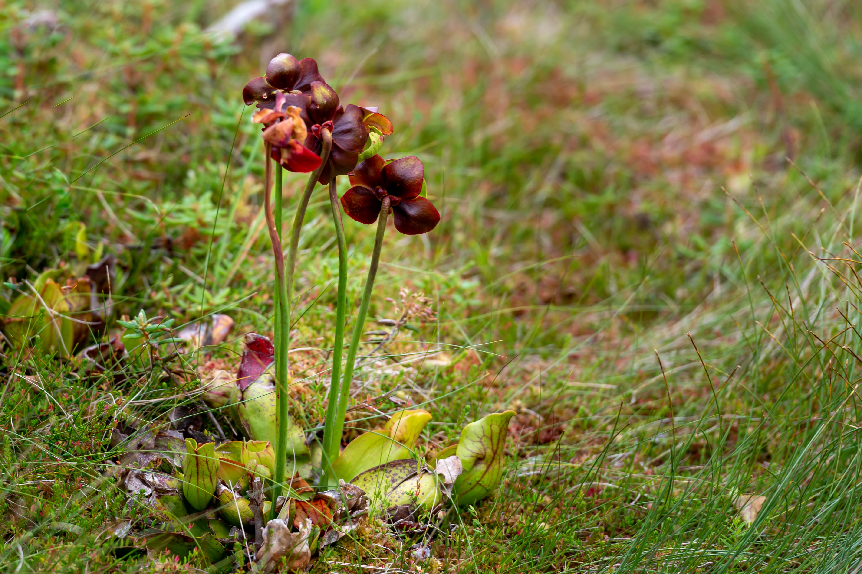
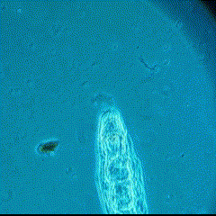
The indirect ecological effect of evolution in pitcher plant rotifers as a response to temperature stress
Alex Mendelson
Alex Mendelson

Slide 2
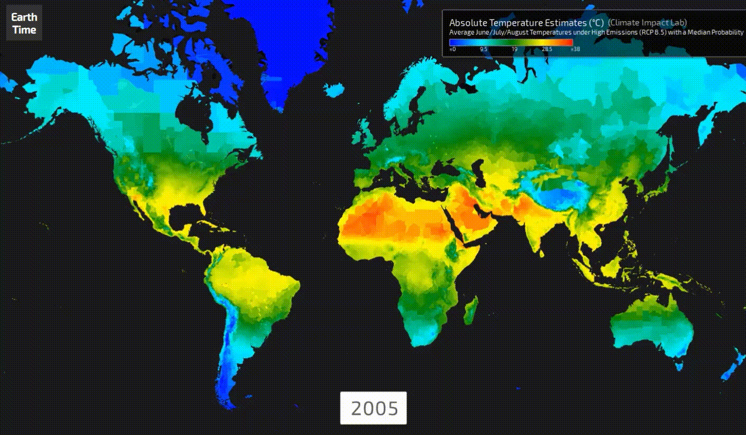
earthtime.org
Notes:
It’s easy to argue anthropogenic climate change is the defining issue of our time.
Map: absolute temperature estimates through the remainder of the 21st century, with some regions projected to experience an increase upward of 4C.
Change in average temperature has far-reaching effects, leading to increased prevalence of forest fires, and sea level rise. All of these factors are important to ecology, and in response to rapid change, populations of organisms have three options:

Slide 3
Move
Change
Die
earthtime.org
Notes:
Poll room: who’s heard of this idea before?
Die refers to local extinction, which can drastically alter the stability of natural communities

Slide 4
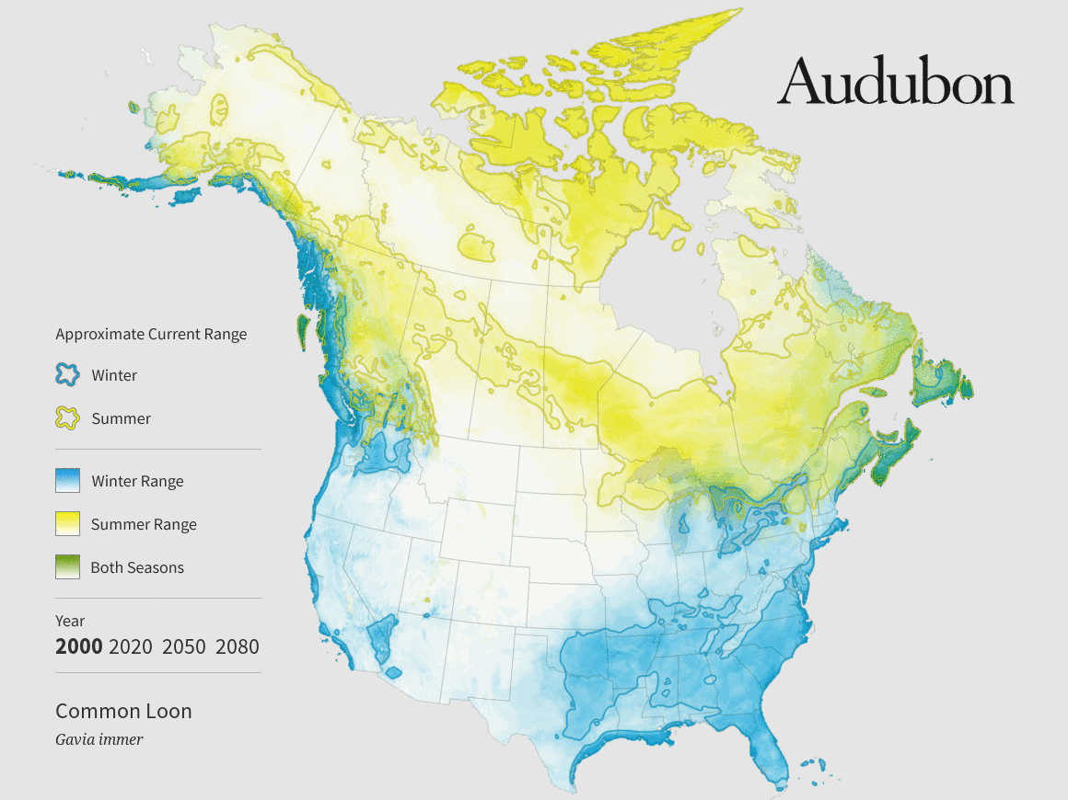
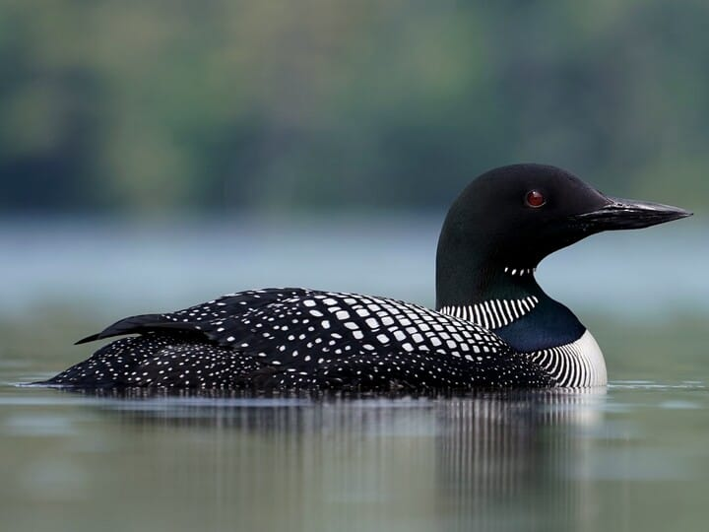
Predicted upward shift of Common Loon range
Christian Hagenlocher
Notes:
Moving is a commonly documented pattern by which populations overcome rapid change.
Here we can see a map of white ash populations in the 1970s in light purple, and in 2015 in dark purple. Note the upward trend as southern populations, and populations at lower elevations, experience declines or local extinction, while populations ine north persist, and even some new populations emerge outside the previous range.

Slide 5
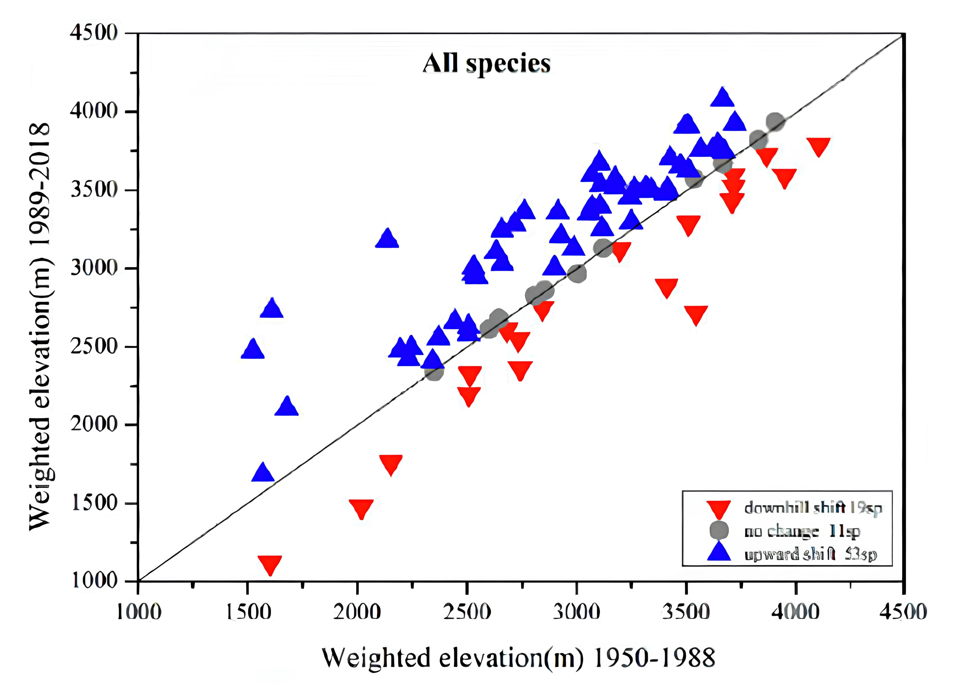
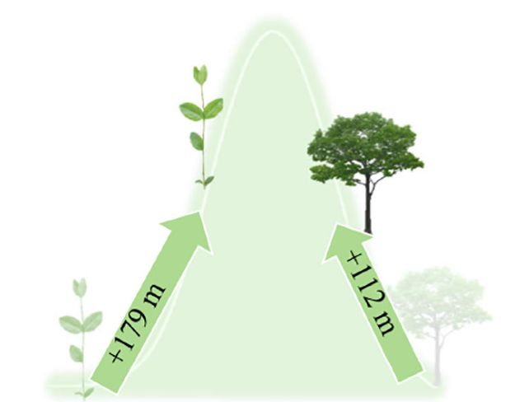
Upward shift of subtropical mountain plants from 1950s to 2010s
Downhill shift (19sp)
No change (11sp)
Upward shift (53sp)

Slide 6
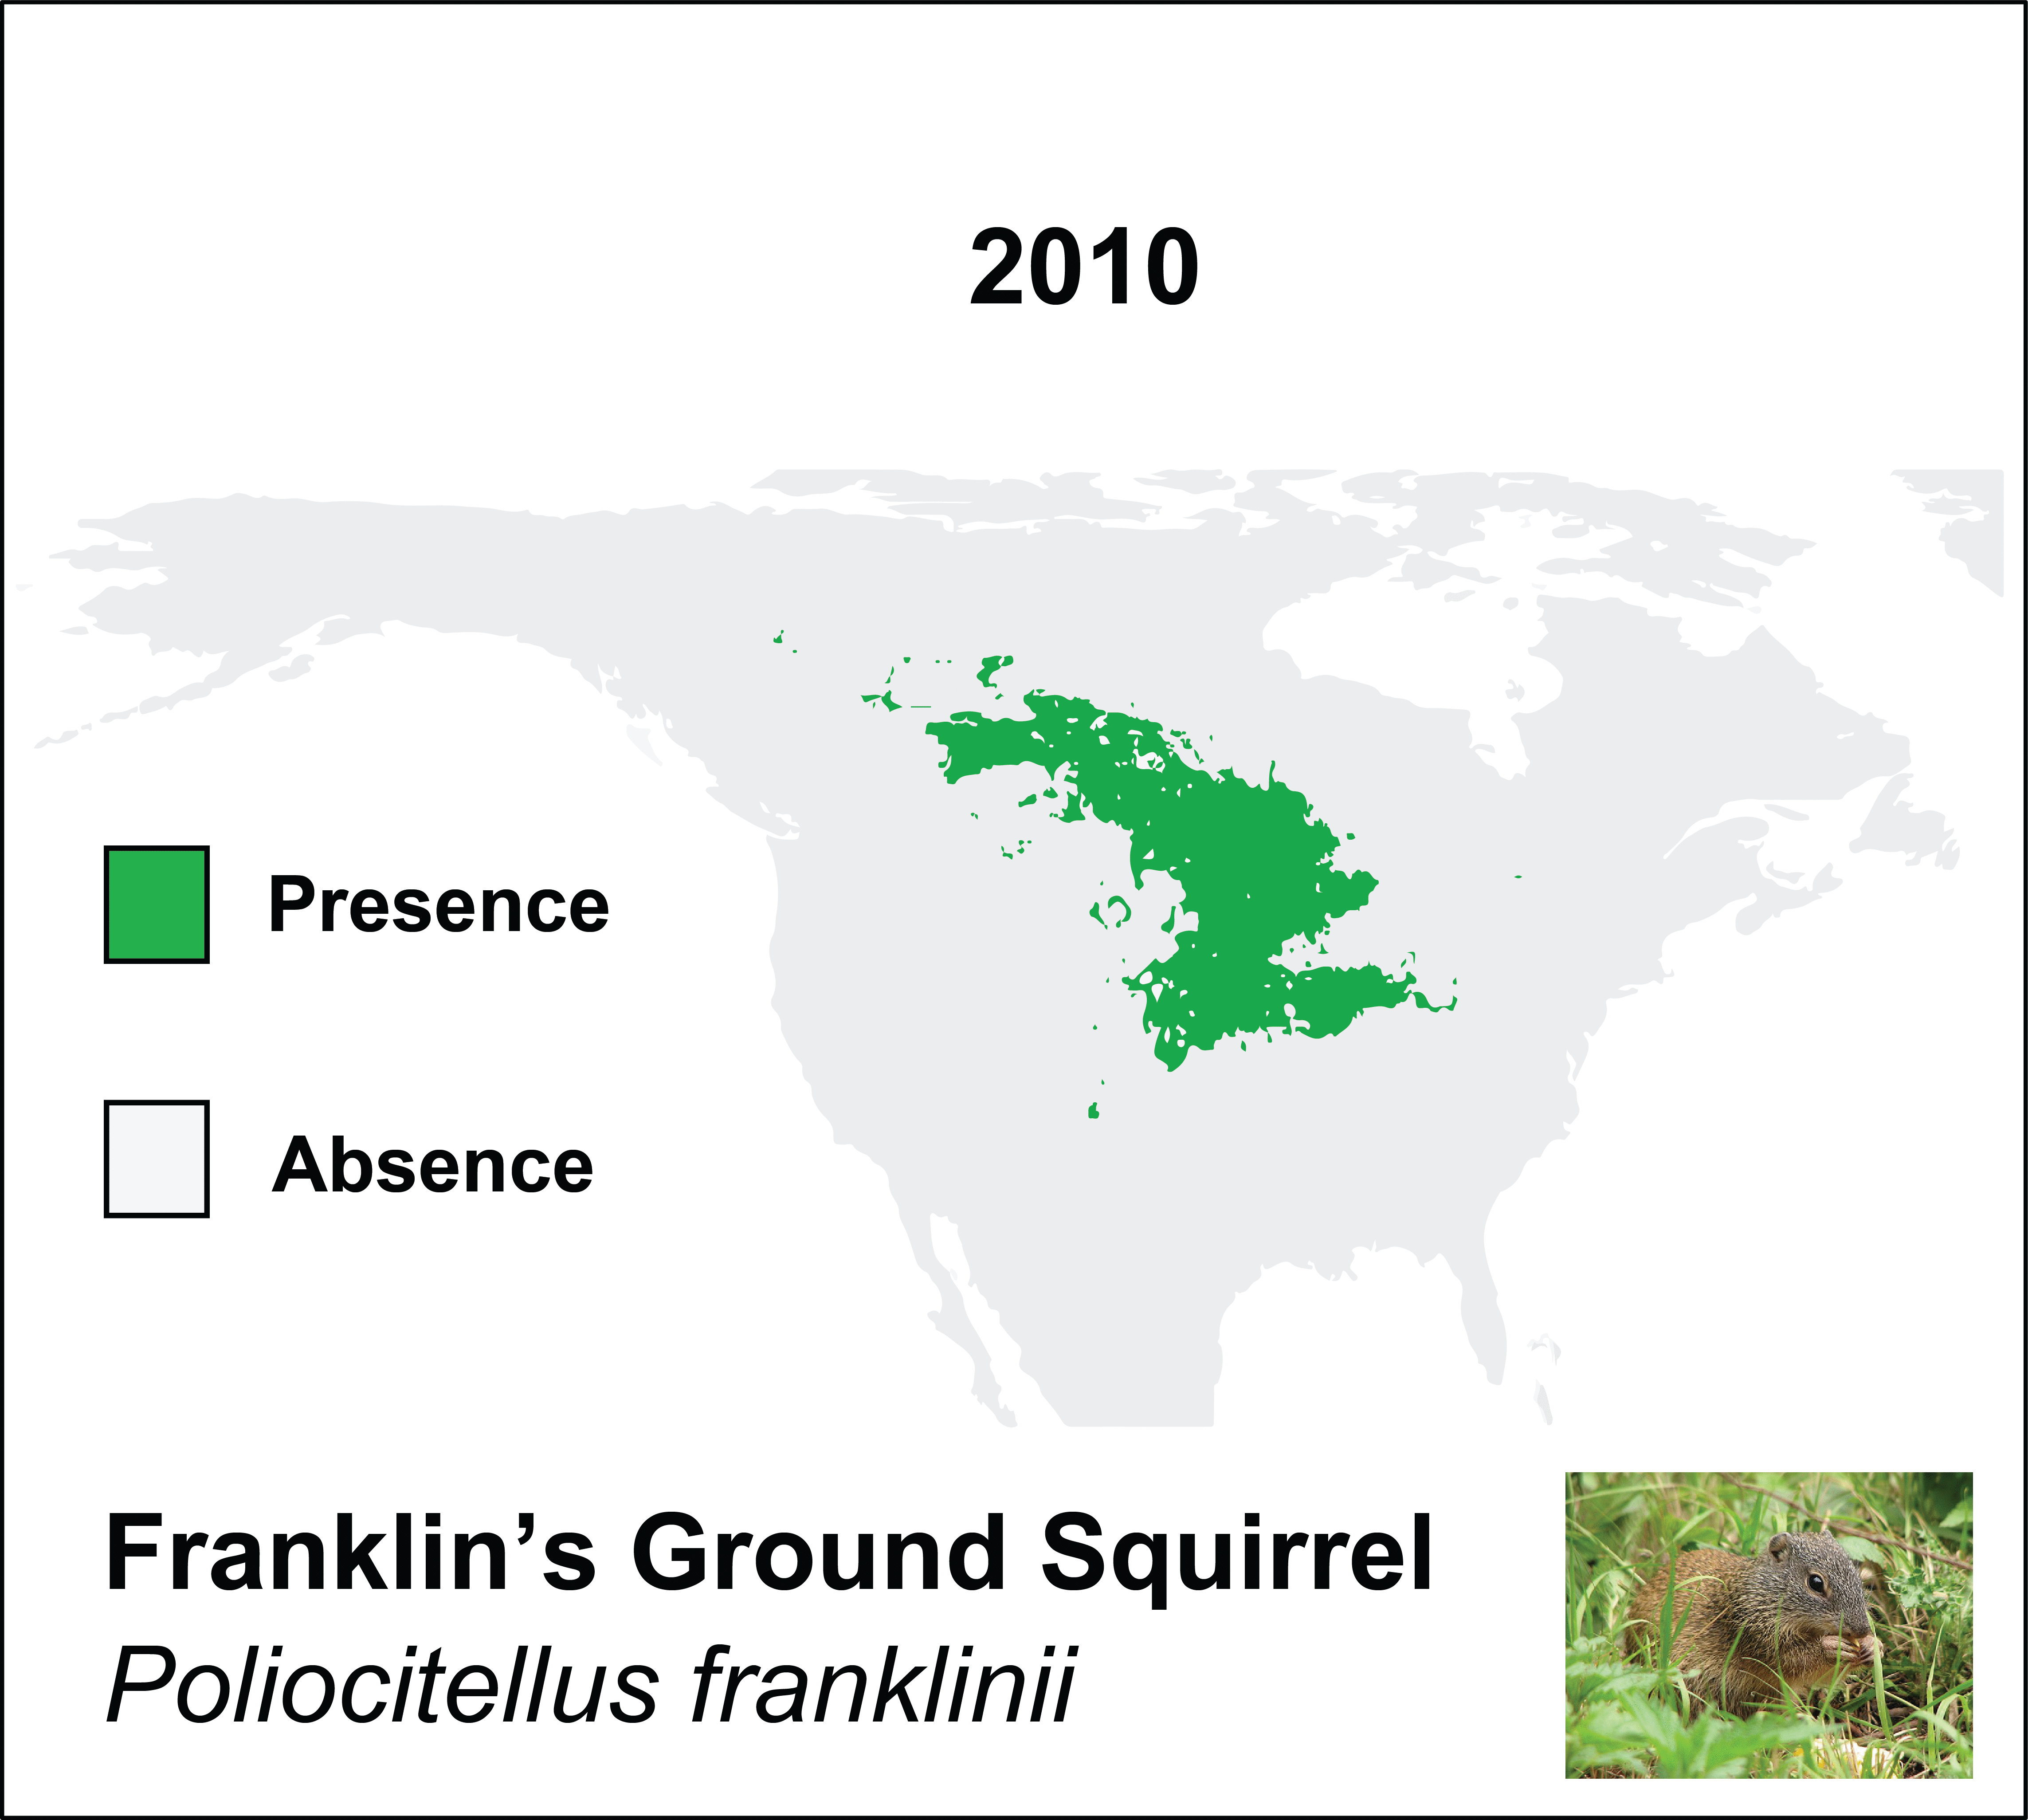
Predicted upward shift in Franklin’s Ground Squirrel range
1970
2015
MegaSDM, Ben Shipley
Notes:
We also see these trends in mammals like Franklin’s ground squirrel, and can predict based on climate models how its range is likely to be pushed further north over the next 50 years.
Split figure into 1 half with gif, the other half with static final image

Slide 7
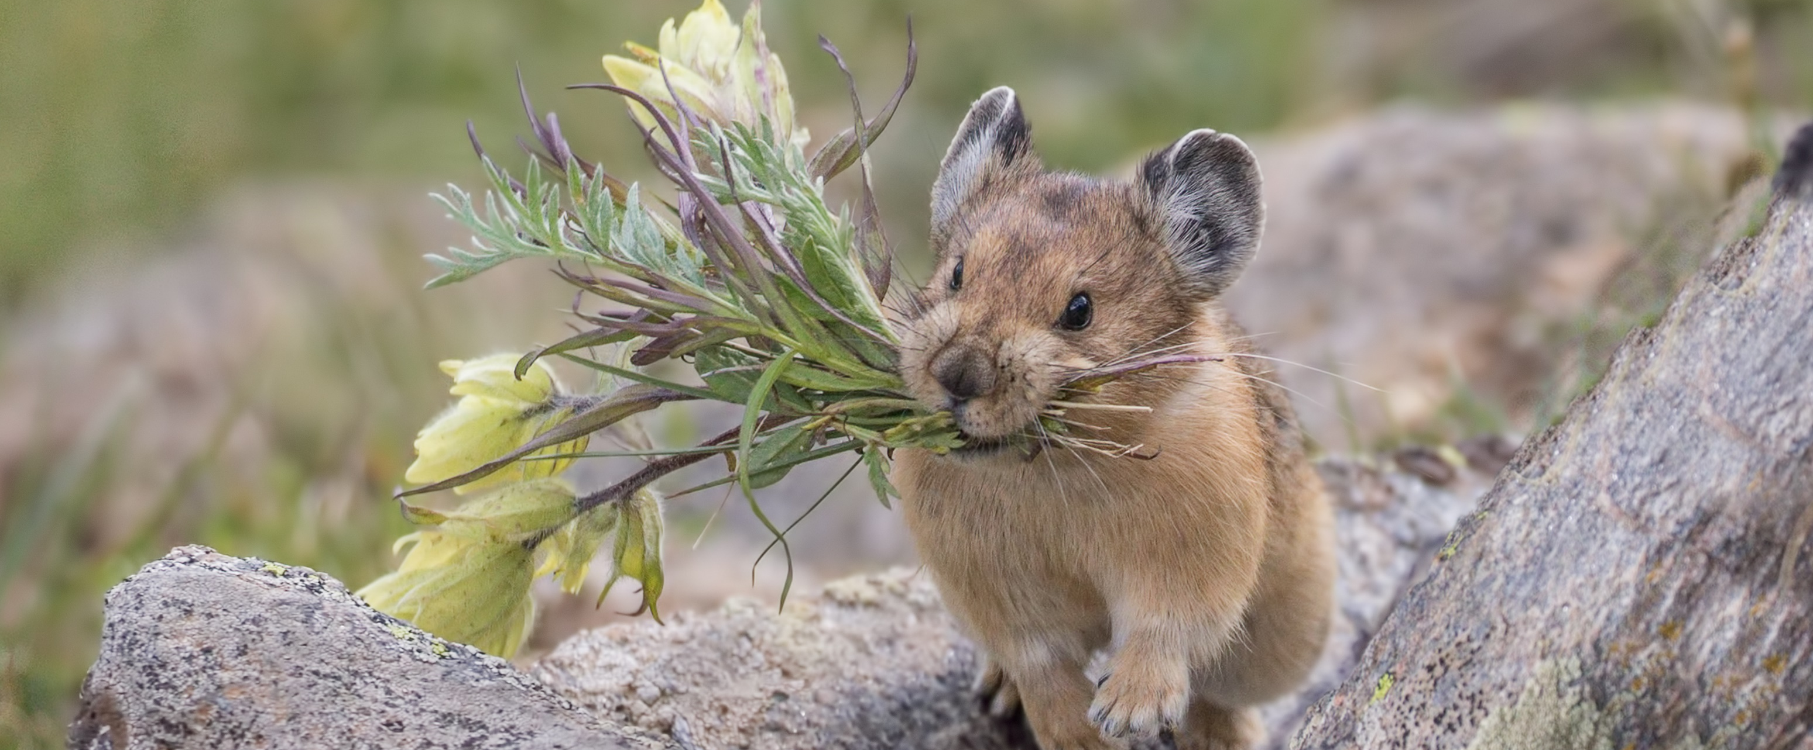
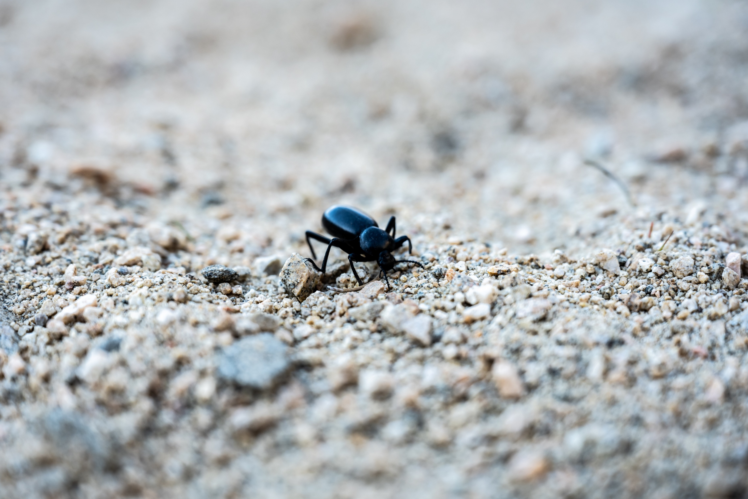
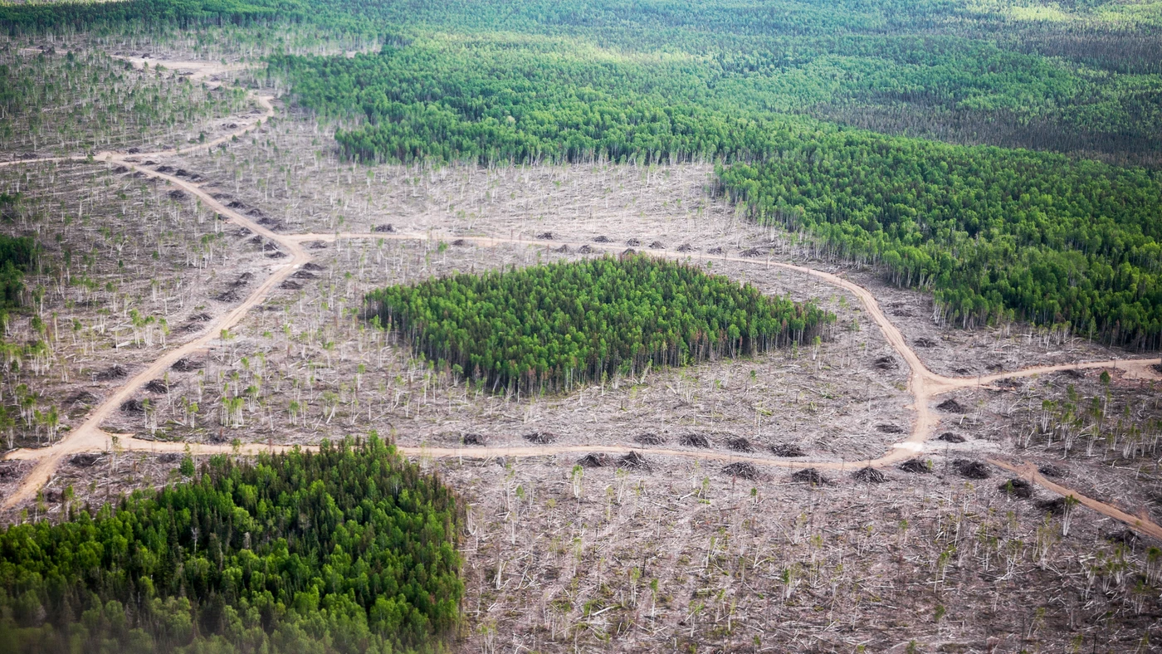
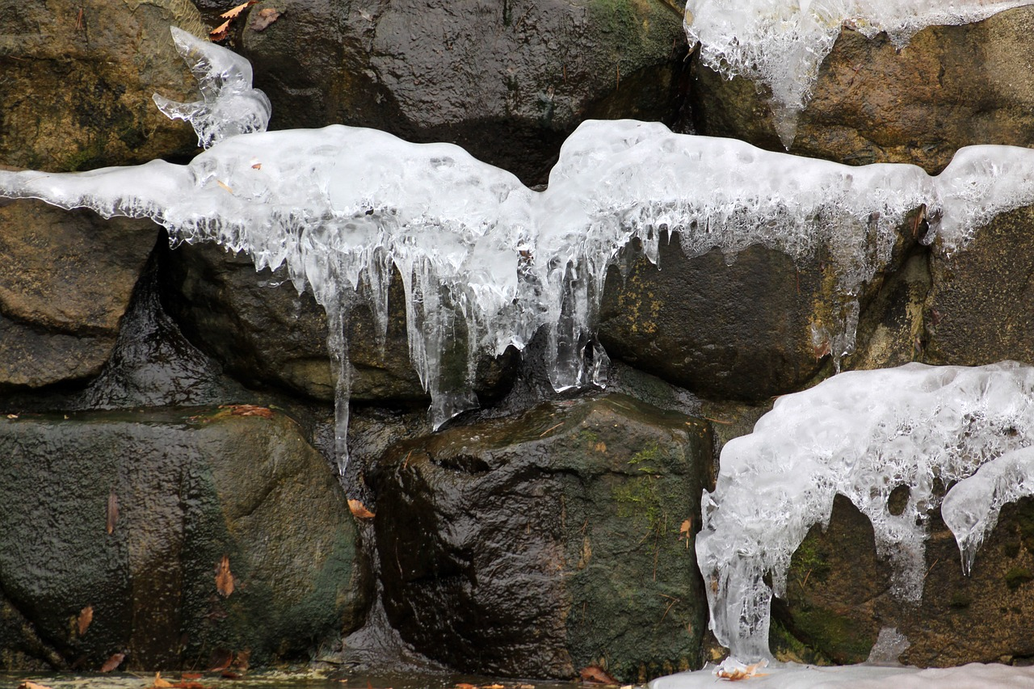
Moving isn’t possible for everyone
Per Breiehagen, Audubon.org
Notes:
However, many species and populations of species are particularly ill-equipped to shift their range fast enough to escape rapid climate change.
Some are pressured by habitat fragmentation; others simply lack the dispersal capability.
Few, like the mountain pika, will find protection in refugia, but these refugia are fragile and temporary.

Slide 8
Moving isn’t possible for everyone
Move
Change
Die
Per Breiehagen, Audubon.org
Notes:
Considering this, to avoid local extinction, populations may be left with only one option: adapt, or better put, change something about themselves either behaviorally or through physical trait changes to tolerate rapid climate change

Slide 9
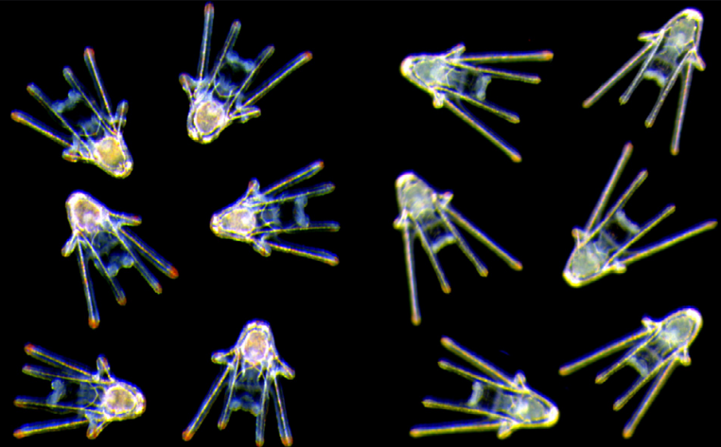
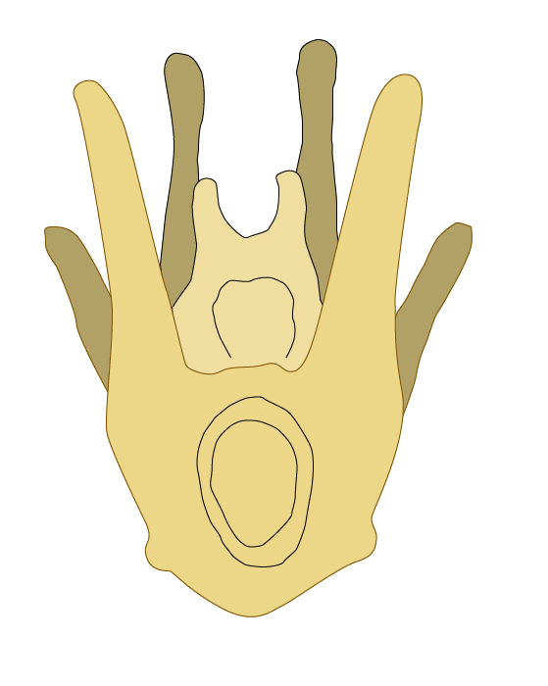
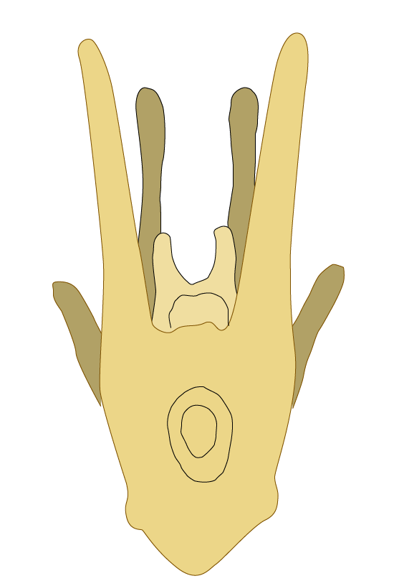
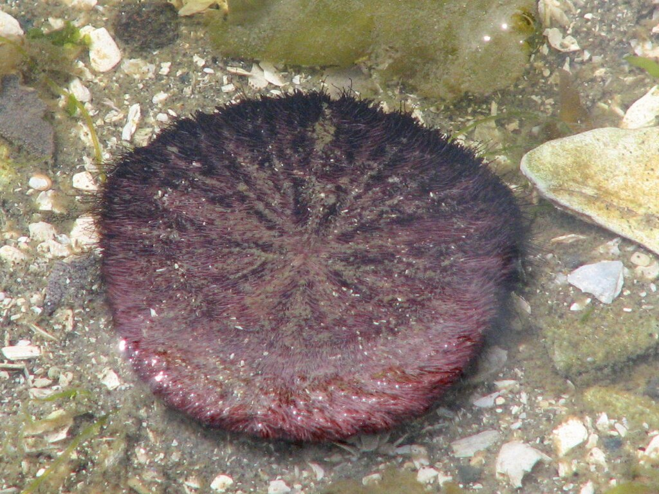
Phenotypic Change
Plasticity
Evolution
Individual level within one generation
Population level across many generations
Generation x₀
Generation x_{n}
[1]
[1]
High resource
Low resource
High
Low
[2]
[1] Peter Nilsson, adapted
[2] D. Gordon E. Robertson
Notes:
These changes in trait, or phenotypic changes, can occur via two pathways:
plastically through phenotypic plasticity, which acts on the individual over the course of a single generation, or
Genetically, through adaptation, where selection for better adapted individuals will change what trait alleles are present in a population
Better illustration of larvae
Include pic of short/long arm larvae

Slide 10
Response to rapid climate change
Plasticity
Plasticity
Individual level within one generation
Individual level within one generation
Fast
High resource
Low resource
Potential for change varies
[1]
[1]
High resource
Low resource
Energetic tradeoffs
Change isn’t directly heritable
Notes:
Practice narrative flow here

Slide 11
Response to rapid climate change
Plasticity
Evolution
Plasticity
Plasticity
Evolution
Individual level within one generation
Population level across many generations
Individual level within one generation
Individual level within one generation
Population level across many generations
Generation x_{n}
Low resource
Generation x_{n}
Low resource
Generation x₀
High resource
Generation x₀
High resource
[1]
[1]
Hot
High resource
Low resource
High
Cold
Low
Notes:
Change evolution example to the same high/low food plasticity example

Slide 12
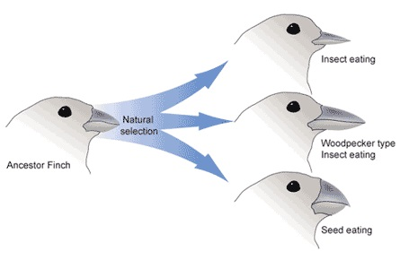
Response to rapid climate change
Evolution
Evolution
Evolution
?
Really slow
Population level across many generations
Population level across many generations
Population level across many generations
Generation x_{n}
Generation x_{n}
Generation x₀
Generation x_{n}
Generation x₀
Generation x₀
Hot
Hot
High
Cold
Cold
Low
Notes:
Talk about microevolutoin vs macroevolution

Slide 13
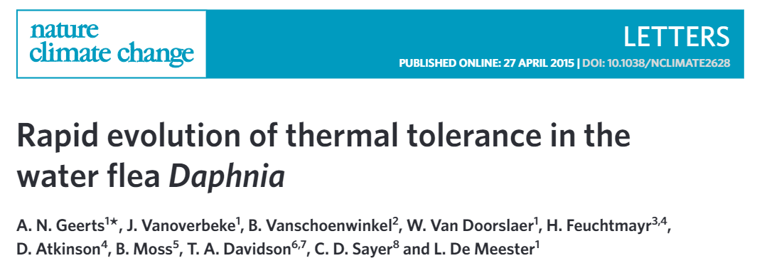
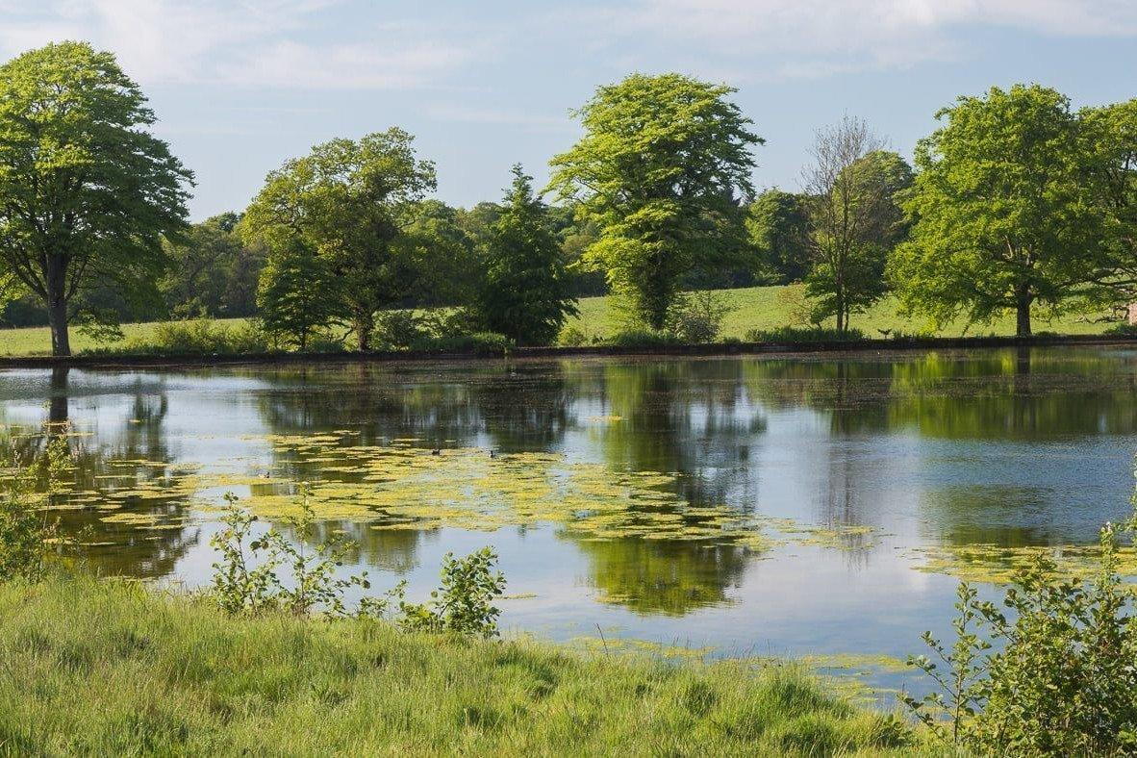
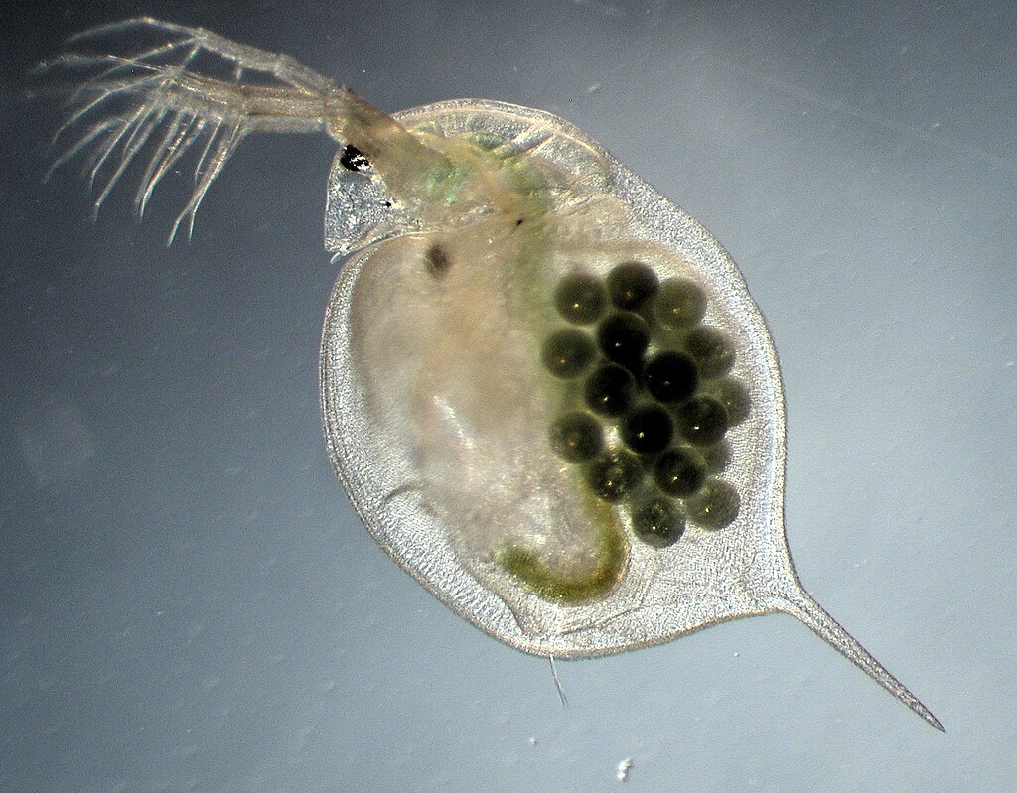
Evidence of rapid evolution
Daphnia magna Photo: Dieter Ebert
Felbrigg Hall Lake Photo: The National Trust

Slide 14
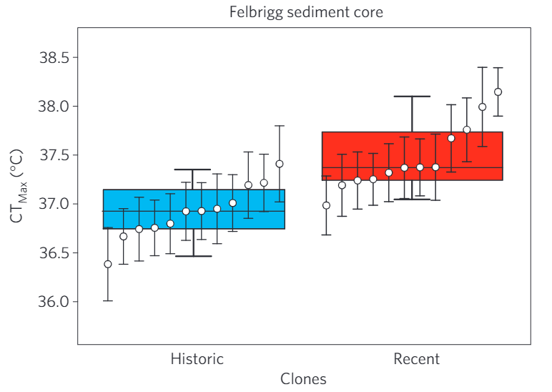
Recent populations have higher CT_{Max} than historic populations
Daphnia magna Photo: Dieter Ebert
Felbrigg Hall Lake Photo: The National Trust
Geerts et al., 2015; adapted
Notes:
Make sure you mention common garden experiment

Slide 15

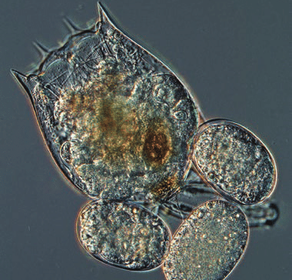

Climate change has direct and indirect effects
Daphnia magna Photo: Dieter Ebert
Brachionus sp. Photo: Karel Šimek
Temp increase
Rapid evolution
Daphnia
Interaction
Competitor
↑ Thermal tolerance
Direct effect
Indirect effect

Slide 16
Trait-mediated indirect effect
Daphnia magna Photo: Dieter Ebert
Brachionus sp. Photo: Karel Šimek
Temp increase
Rapid evolution
Daphnia
Interaction
Competitor
↑ Thermal tolerance
Direct effect
Indirect effect

Slide 17
Evolution-mediated indirect effect
Daphnia magna Photo: Dieter Ebert
Brachionus sp. Photo: Karel Šimek
Temp increase
Rapid evolution
Daphnia
Interaction
Competitor
↑ Thermal tolerance
Direct effect
Indirect effect

Slide 18
Evolution-mediated indirect effect
in community context
Daphnia magna Photo: Dieter Ebert
Brachionus sp. Photo: Karel Šimek
Temp increase
Rapid evolution
Daphnia
Interaction
Competitor
↑ Thermal tolerance
Direct effect
Indirect effect
Notes:
Save this for the very end, just move on without the confusing added boxes

Slide 19
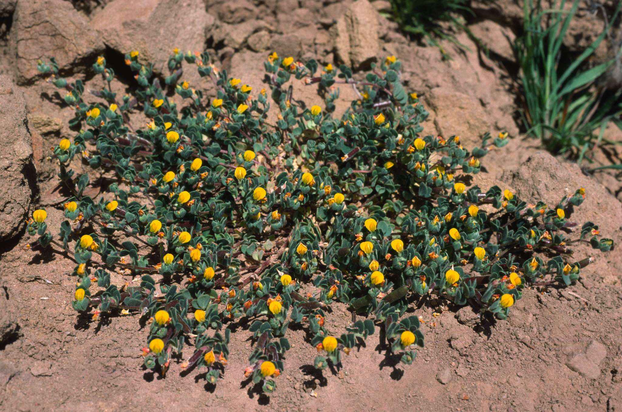
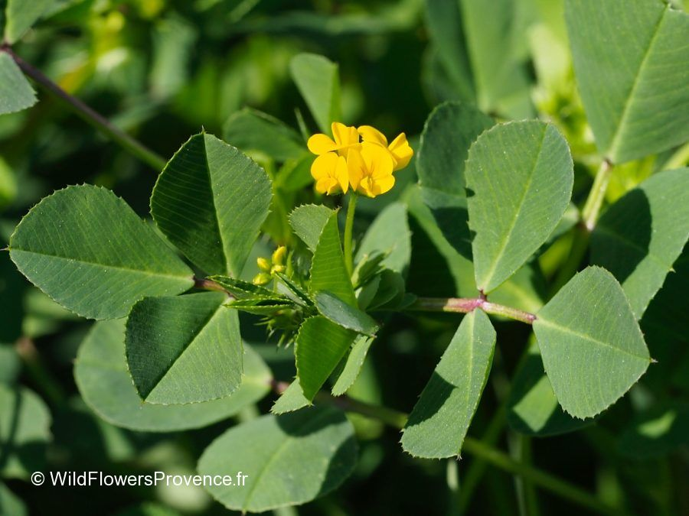
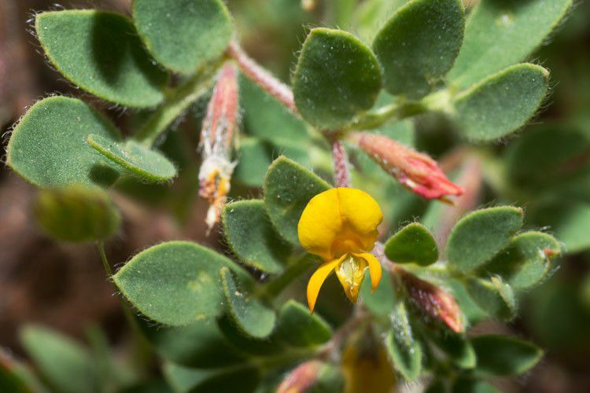
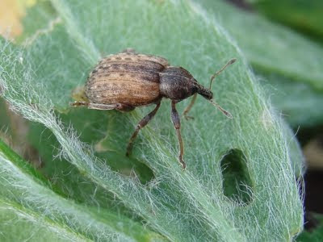
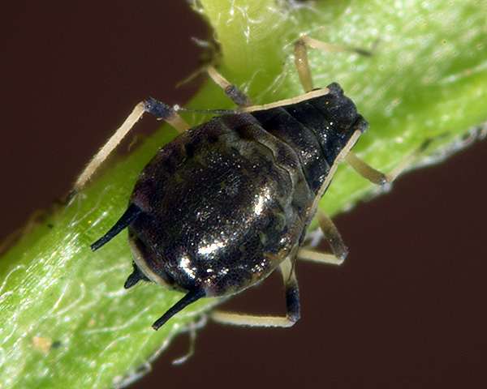
Evolutionary indirect effects of biological invasion
Jennifer Lau, 2012
Acmispon wrangelianus
Medicago polymorpha
wildflowersprovence.fr
Gary McDonald, Calflora
CarrizoPhoto, Flickr
Sam Wells
InfluentialPoints.com

Slide 20
Invasion has evolution-mediated indirect effects on ecology
Acmispon evolves weaker resistance to Hypera herbivory and stronger resistance to aphid herbivory only in the presence of Medicago
Competition
Aphids
Hypera
Herbivory
Herbivory
Lau, 2012
Resistance
Resistance
What about climate change?
Competition
Acmispon
Medicago
Notes:
Fix aphid genus name
Remove final indirect effect of Medicago on herbivore competition

Slide 21
Trait-mediated indirect effects of climate change
Climate Change
Plastic Change
Species A
Interaction
Species B

Slide 22
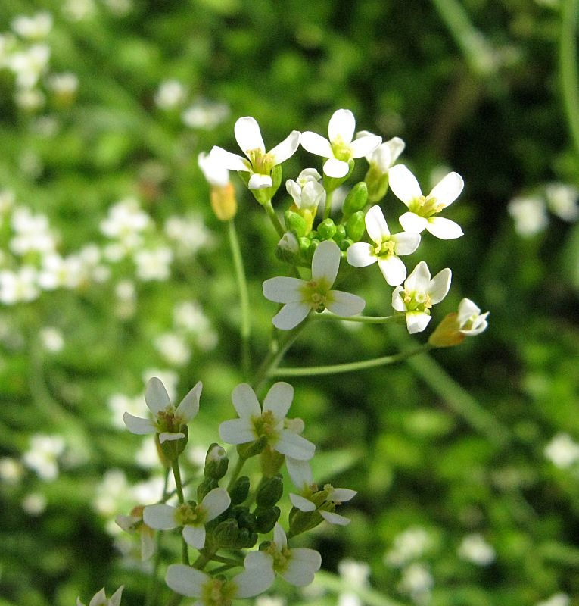
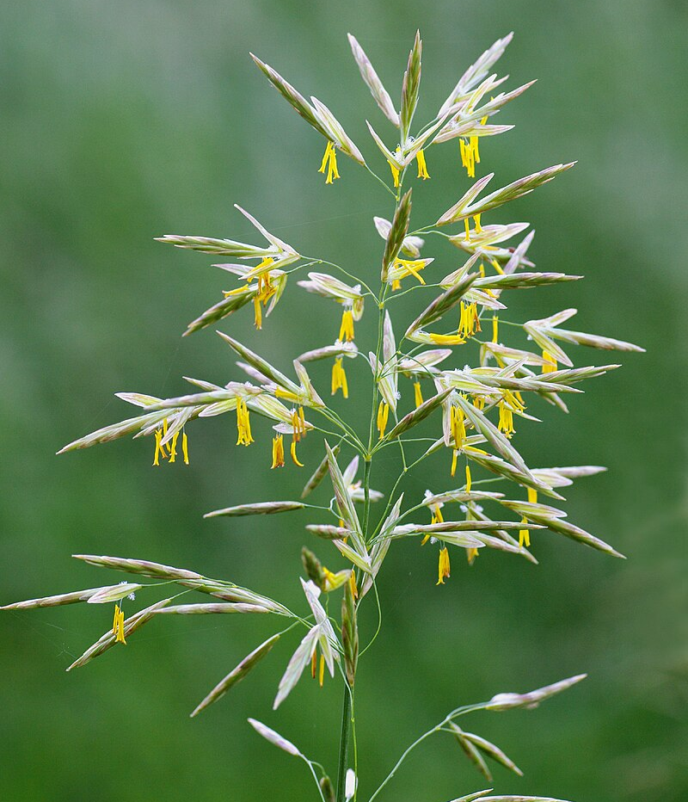
Trait-mediated indirect effects of climate change
Arabidopsis thaliana
Climate Change
Increased growth
Plastic response
Mariarosaria Mazzacane
eCO₂
Competition
Bromus inermis
No direct effect
Stronger competition
Indirect effect
Christian Fischer
Lau et al., 2014

Slide 23
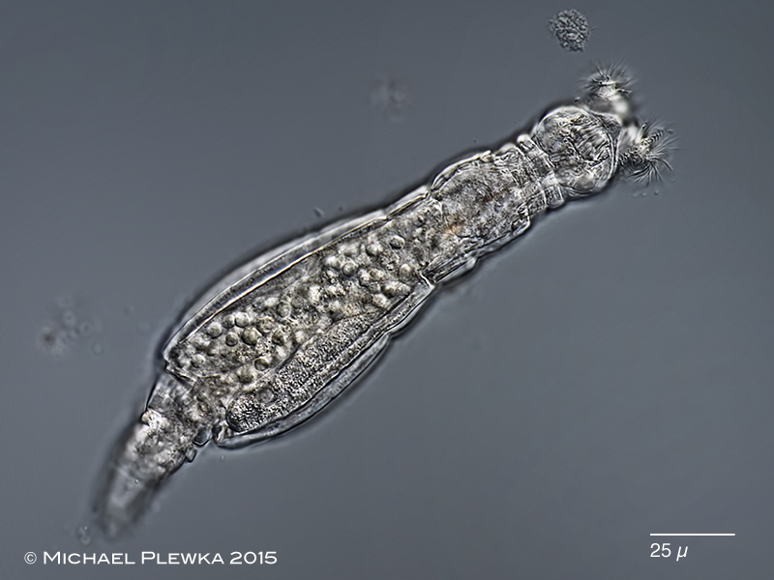
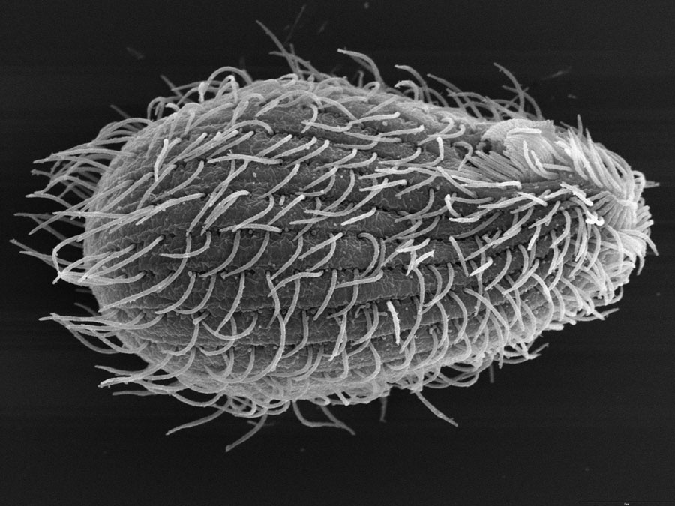
Evolution-mediated indirect effects of climate change?
Michael Plewka
Brian Farley
Rapid evolution
Competition
Climate Change
Species A
Interaction
Species B
???

Slide 24
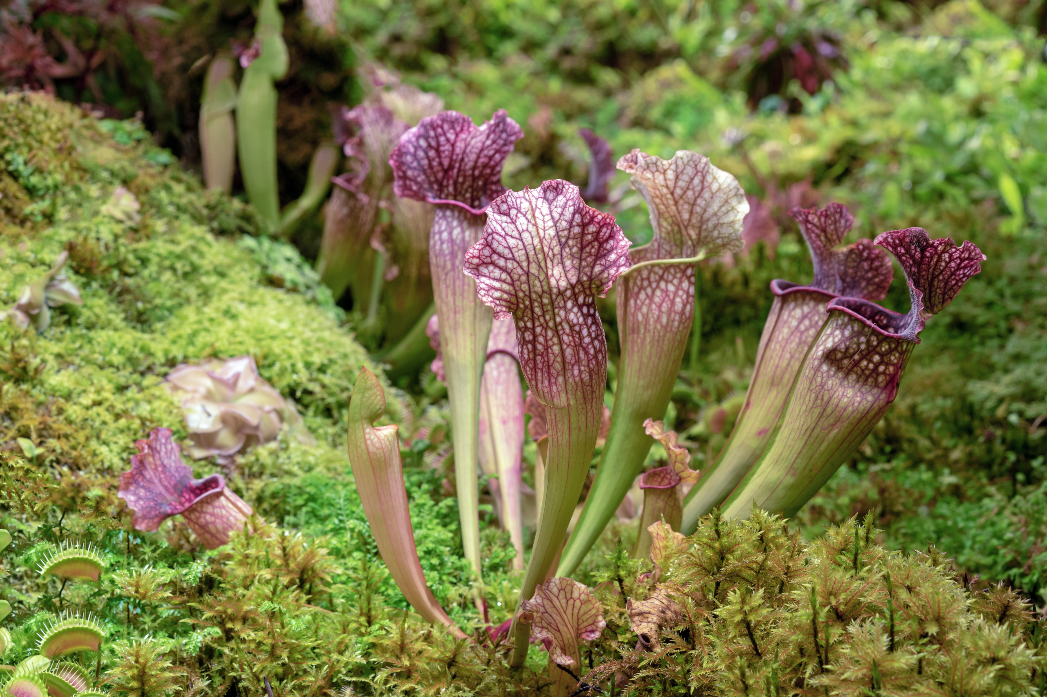
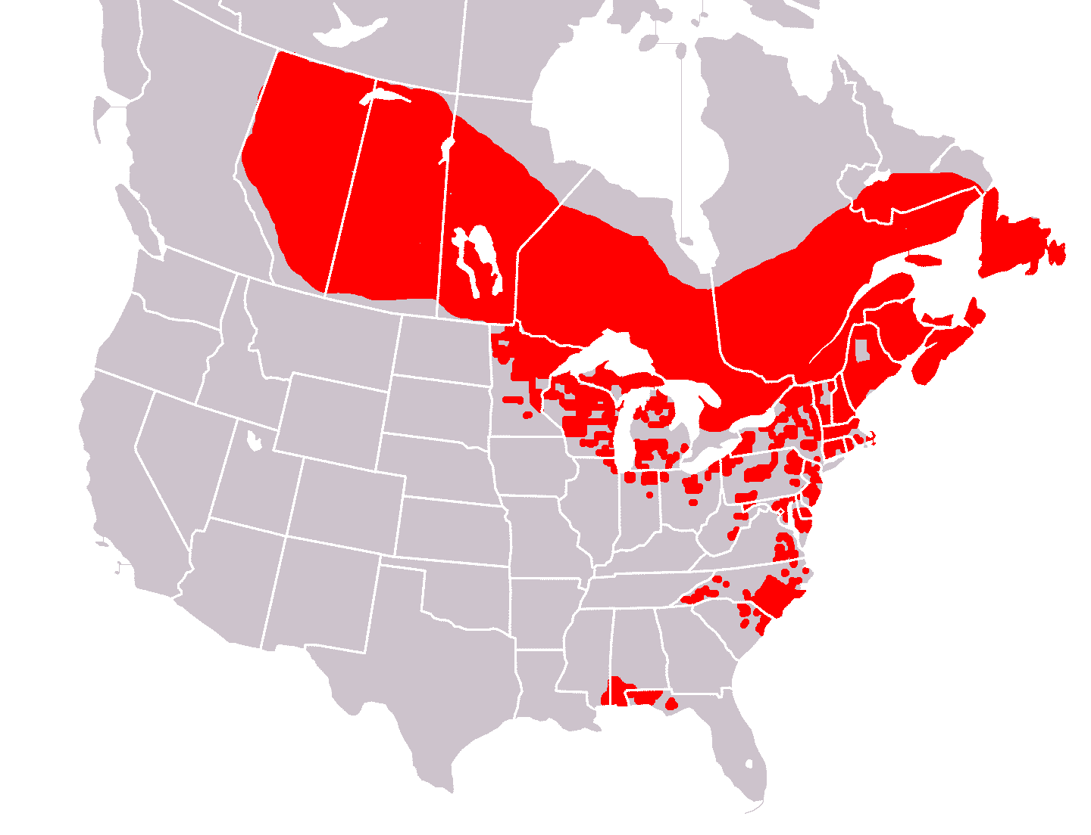
Sarracenia purpurea
Valemaxxx, Adobe Stock

Slide 25
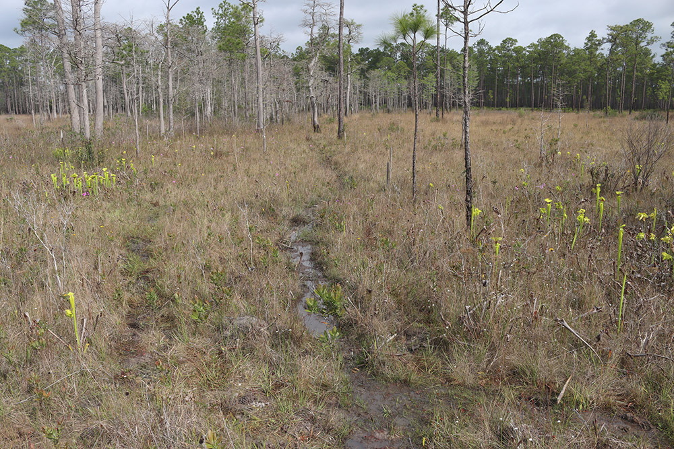
Sarracenia purpurea
Valemaxxx, Adobe Stock
Rob Diaz De Villegas

Slide 26
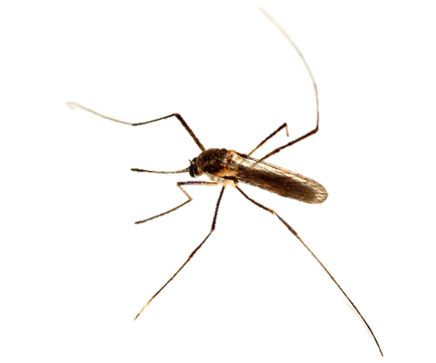
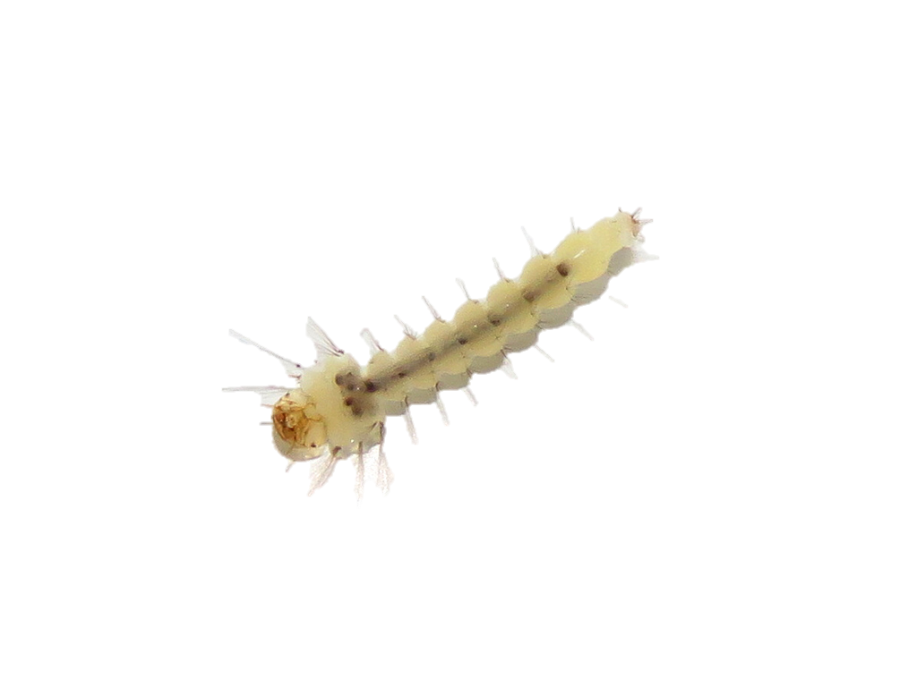
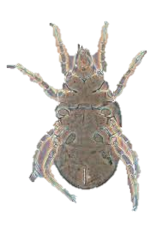
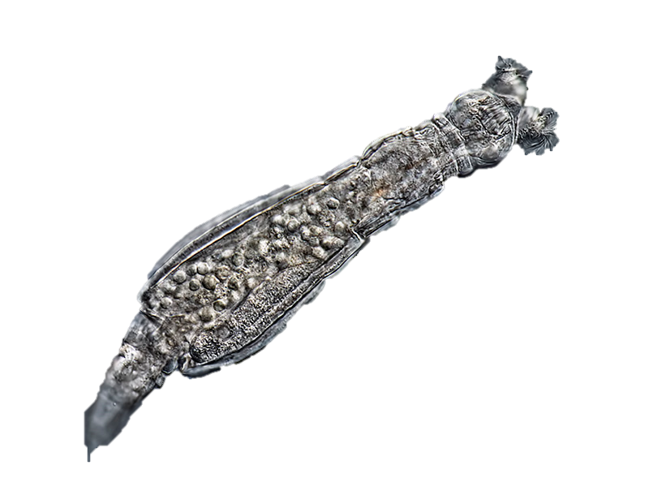
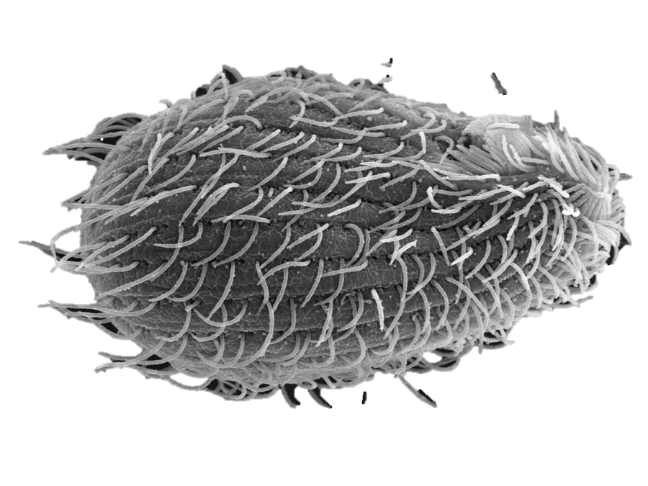

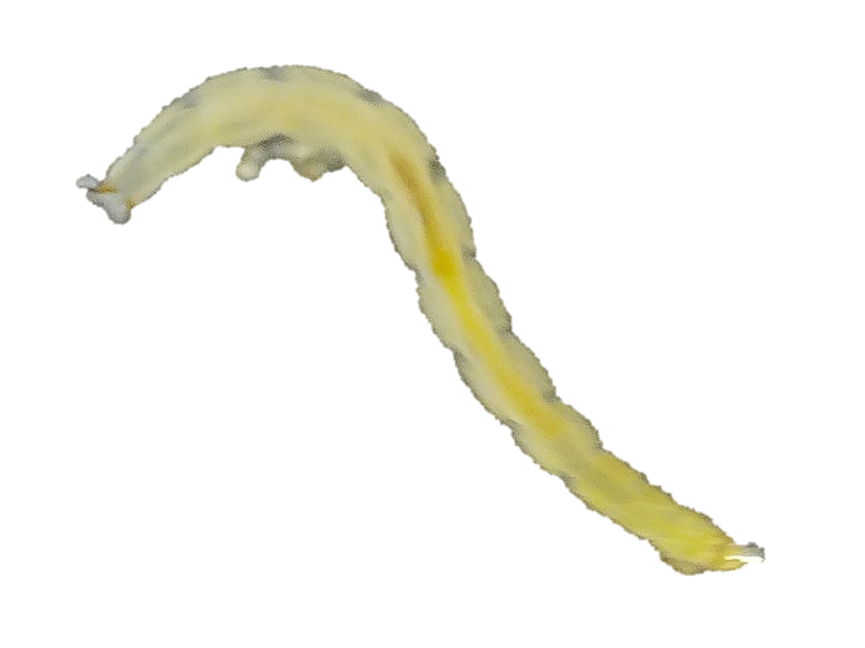
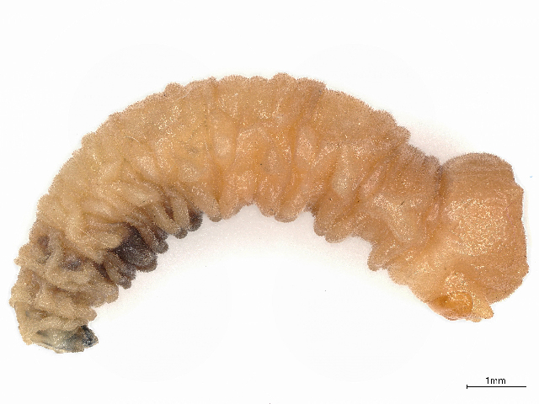
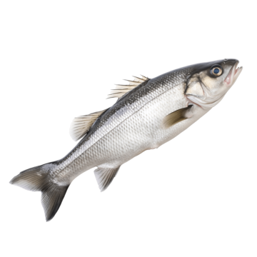
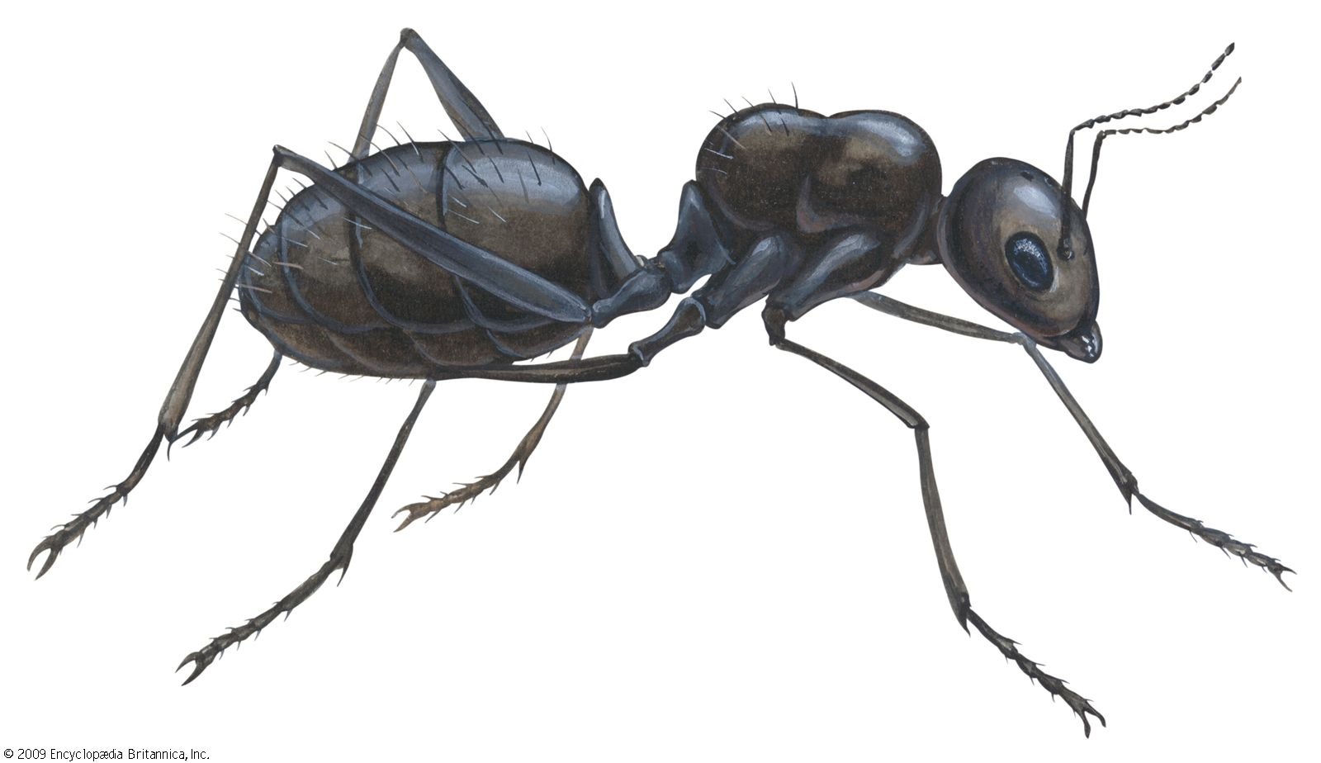
Sarracenia purpurea phytotelmic community
Wyeomyia smithii
Bacterivores
Omnivores
Mosquito Larvae
Rotifers
Protists
Mites
Microbes
Detritivores
Prey
Midge & Fly Larvae
Valemaxxx, Adobe Stock

Slide 27
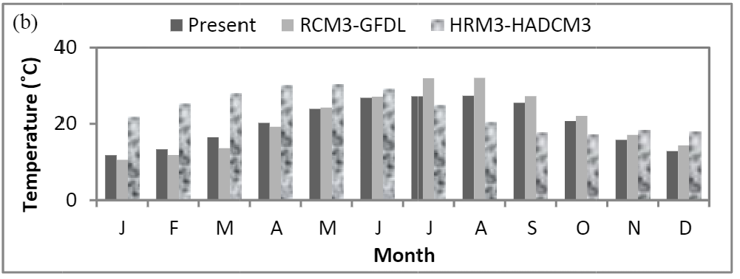
Temperature increase predicted for populations of S. purpurea
Rob Diaz De Villegas
Apalachicola National Forest
Chen et al., 2014
Valemaxxx, Adobe Stock

Slide 28
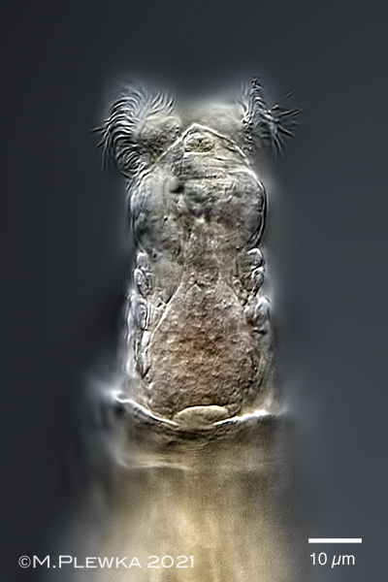
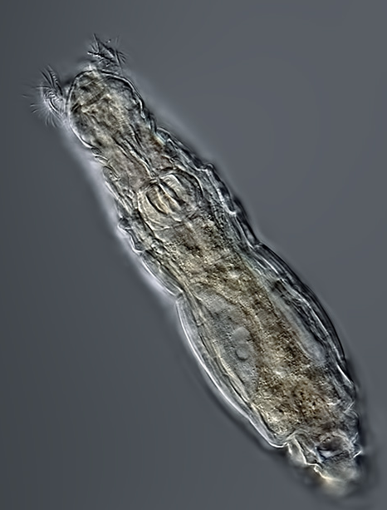
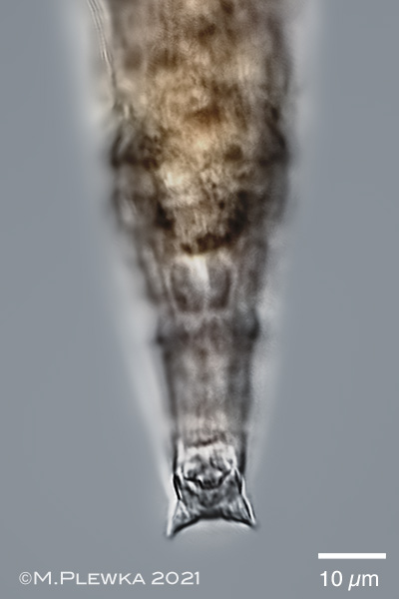
Habrotrocha rosa
Bacterivores
Rotifers
Protists
Michael Plewka
Microbes
Prey
25 µm
Michael Plewka
Michael Plewka

Slide 29
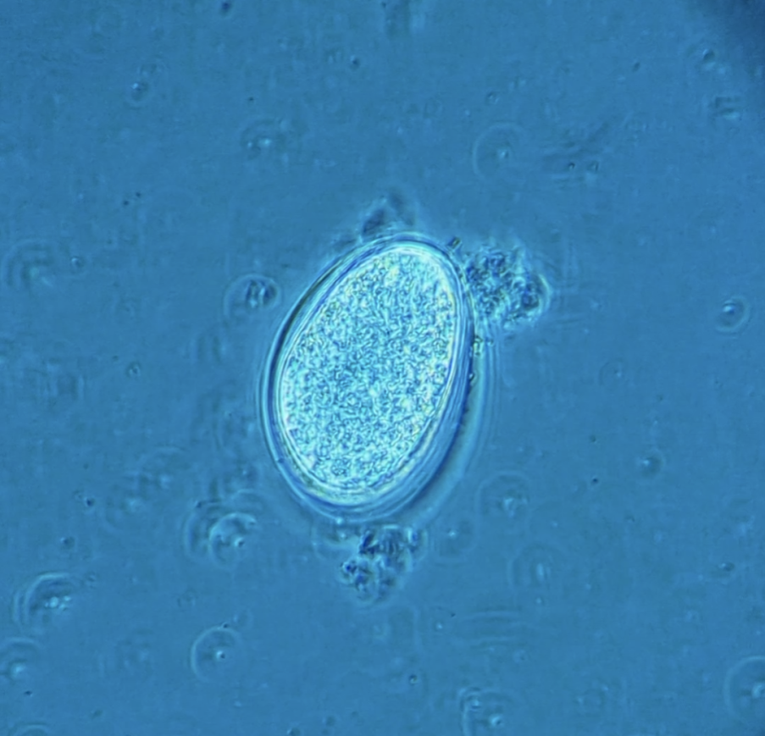
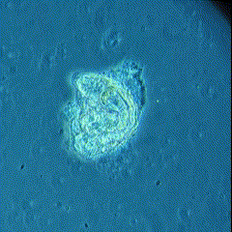
Habrotrocha rosa
Obligately parthenogenetic (apomixis) Offspring are clonal
Generation time 1–2 days
Egg (~6 hours)
Hatching (~12 hours)
Adult (~24 hours)

Slide 30
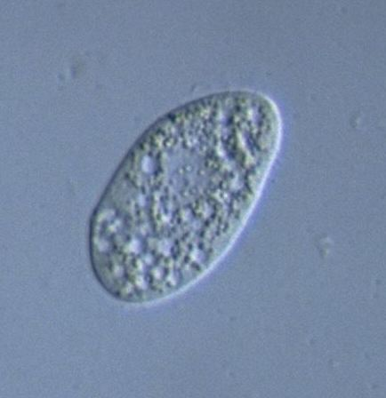
Natural Competitor: Tetrahymena sp.
Bacterivores
Competition
Rotifers
Protists
Microbes
Brian Farley
Y. Tsukii
Notes:
*cut species name, just Tetrahymena sp.

Slide 31
Aims
Aim 1: Determine variation in response to stressful temperature
Q₁: At what spatial scale does variation in H. rosa response to stressful temperature exist?
Site
Plant
Leaf
Notes:
cut hypothesis from here, save hypothesis for later
Q; “at what spatial scale do you see variation”
Add figure with concentric circles to help illustrate that

Slide 32
Aims
Aim 1: Determine variation in response to stressful temperature
Q₁: At what spatial scale does variation in H. rosa response to stressful temperature exist?
Site
Plant
Leaf
Notes:
cut hypothesis from here, save hypothesis for later
Q; “at what spatial scale do you see variation”
Add figure with concentric circles to help illustrate that

Slide 33
Aims
Aim 1: Determine variation in response to stressful temperature
Q₁: At what spatial scale does variation in H. rosa response to stressful temperature exist?
Site
Plant
Leaf
Notes:
cut hypothesis from here, save hypothesis for later
Q; “at what spatial scale do you see variation”
Add figure with concentric circles to help illustrate that

Slide 34
Aims
Aim 2.1: Measure H. rosa evolution in response to stressful temperature
Q_{2.1}: Do diverse populations of H. rosa evolve changes in size, respiration rate, or population growth rate in response to stressful temperature?
Aim 2.2: Identify evolution-mediated indirect effects of temperature on competition
Q_{2.2}: Do diverse populations of H. rosa, when left to evolve in different temperatures, exhibit changes—good or bad—in the way they interact with a natural competitor (Tetrahymena)?
Notes:
cut hypothesis from here, save hypothesis for later
Q; “at what spatial scale do you see variation”
Add figure with concentric circles to help illustrate that

Slide 35
Aims
Aim 2.1: Measure evolution in response to stressful temperature
Aim 2.2: Identify evolution-mediated indirect effects of temperature on competition
Aim 2.3: Investigate mechanisms behind change in competitive ability
Q_{2.3}: Do underlying mechanisms of H. rosa competitive ability evolve in response to stressful temperature?
Notes:
cut hypothesis from here, save hypothesis for later
Q; “at what spatial scale do you see variation”
Add figure with concentric circles to help illustrate that

Slide 36
Aims
Aim 1: Determine variation in response to stressful temperature
Aim 2.1: Measure evolution in response to stressful temperature
Aim 2.2: Identify evolution-mediated indirect effects of temperature on competition
Aim 2.3: Investigate mechanisms behind change in competitive ability
Notes:
cut hypothesis from here, save hypothesis for later
Q; “at what spatial scale do you see variation”
Add figure with concentric circles to help illustrate that

Slide 37


Field Sampling and Isolation
Leaf water
At each of 2 sites:
Sample 5 leaves of different plants that contain H. rosa

Slide 38


Field Sampling and Isolation
Leaf water
1st Isolation
2nd Isolation
Pulled glass pipette

Slide 39

Field Sampling and Isolation
Leaf water
1st Isolation
2nd Isolation
3rd Isolation
24-well tissue culture plate

Slide 40


Field Sampling and Isolation
Isolated rotifer
0.5 mL
Plasota medium
24-well tissue culture plate

Slide 41
Field Sampling and Isolation
Repeat 24 times per leaf water sample
Goal: 5 successful clones
1st Isolation
2nd Isolation
Isolated rotifer
0.5 mL
Plasota medium
24-well tissue culture plate

Slide 42


Clonal Stock Cultures
n = 5 per leaf water sample
1x
Wheat seed
100 mL
Plasota medium
24-well tissue culture plate

Slide 43

Clonal Stock Cultures
n = 50
Notes:
Spend more time here, “here’s the point of all that”

Slide 44
Aim 1: Determine variation in response to stressful temperature
Q₁: At what spatial scale does variation in H. rosa response to stressful temperature exist?
Site
Plant
Leaf
Notes:
Justify why you’re asking this question --- what is the population here, because evolution occurs in populations
Maybe here is when you talk about how individuals get from leaf to leaf

Slide 45

Aim 1: Determine variation in response to stressful temperature
Clonal Stock Culture
n = 6 Experimental Cultures
28°C
25°C
20 mL Plasota medium
5 rotifers per mL
Notes:
Mention growth chambers

Slide 46

Aim 1: Determine variation in response to stressful temperature
Leaf
Leaf
H₁: Variation in H. rosa response to stressful temperature will exist within individual leaves of S. purpurea, and thus at all three spatial scales
n = 3
Notes:
Remove opacity circles and just add one circle “ o -> n = 3”
Reaction norms!
3-5 genotyes: some don’t change, some increase, some decrease
How does their fitness change
Price equatoion
Plastic responses from adaptive responses
May partition plastic responses from adaptive responses
Underused methodology I’d like to give a shot

Slide 47
Aim 1: Determine variation in response to stressful temperature
Leaf
Leaf
Measure traits:
14 days
Size (estimated mass)
Population growth rate
Respiration rate

Slide 48

Aim 1: Determine variation in response to stressful temperature
Measuring Size
Sample of 20 rotifers
Fixed in 4% formalin-40% sucrose solution
Imaged using an inverted compound microscope
Length and width measured using ImageJ
n = 20

Slide 49


Aim 1: Determine variation in response to stressful temperature
Estimating Population Growth Rate
Experimental cultures vortex mixed for 5 seconds
0.3 mL of ea. homogenized culture added to 24-well plate
Rotifers scored
Repeat daily, 14 days
Use growth curve to estimate population growth rate using ‘growthrates’ package in R

Slide 50


Aim 1: Determine variation in response to stressful temperature
Estimating Respiration Rate
Sample of 20 rotifers
Loligo Systems microplate respirometry system
Estimate respiration rate from rate of O₂ consumption

Slide 51
Aim 1:
Analysis
Leaf
Leaf
Separate nested ANOVAs to compare reaction norms for each trait between sites, among leaves, and among clones (spatial scales as random effects)
Use variance partitioning to describe how much variance in each trait can be attributed to site, leaf, or clone

Slide 52

Aim 2: Evolution experiments
n = 10 random clonal stock cultures
n = 40 experimental cultures per mixed-genotype ID

Slide 53
Aim 2:
~5 generations
1
Ambient Temp Buffer
Ambient Temp Buffer

Slide 54
Aim 2.1:
Δ Population growth rate
Δ Respiration rate
Δ Size
=
Evolution in response to temperature
H_{2.1}: Populations of H. rosa will evolve changes in size, respiration rate, or population growth rate in response to stressful temperature
Notes:
Be sure to mention that all of these comparisons will be done in the ambient temperatures as well
Does evolution change competitive ability in stressful environment, and in ambient environment
Redesign figure with evolutionary history reflected more clearly on the right side

Slide 55
Δ Rotifer Abundance
=
Competitive Response

Slide 56
Δ Protist Abundance
=
Competitive Effect

Slide 57
Aim 2.2:
Δ Competitive Response
=
Evolution-mediated indirect effect of temperature

Slide 58
Aim 2.2:
Δ Competitive Effect
=
Evolution-mediated indirect effect of temperature
H_{2.2}: Diverse populations of H. rosa, when left to evolve in different temperatures, will exhibit changes—good or bad—in the way they interact with a natural competitor (Tetrahymena)

Slide 59

Aims 2.1 & 2.2:
Analysis
Separate three-factor ANOVAs to compare population growth rate, size, and respiration rate among:
Evolutionary history
Contemporary temperature
Competition
Path analysis (via structural equation modeling) to describe both direct and indirect effects
Notes:
3 way interaction would be the most interesting result:
The strength of the two-way interaction depends on something else
Evolution by competition interaction would mean evolution affects your competitive ability
A three-way interaction would be the extent to which evolution effects your competitive ability depends on your evolutionary history of temperature
Spend a little time on path analysis
Table describing possible interactions from ANOVA results that would answer specific questions (2.1 and 2.2 questions)

Slide 60


Aim 2.3: Investigate mechanisms behind change in competitive ability
R* is the minimum resource level required to maintain a positive population growth rate
Population Growth Rate
R*₂

Slide 61
Aim 2.3: Investigate mechanisms behind change in competitive ability
Inoculate mixed-genotype clones from both evol. histories of temp with bacteria
Measure abundance after 10 days to estimate rough population growth rate
Population Growth Rate
Calculate R* values
Compare R* values between evolutionary histories using two-sample t-test
10⁻⁵ 10⁻⁴ 10⁻³ 10⁻² 10⁻¹
[bacteria]
R*

Slide 62
Aim 2.3: Investigate mechanisms behind change in competitive ability
H_{2.3}: The R* of populations of H. rosa with a stressful evolutionary history will differ from populations with an ambient evolutionary history.
Population Growth Rate
R*₂

Slide 63

The big picture
Communities are complex
Current understanding of global change affecting ecology centered around direct effects
Indirect effects, mediated by rapid evolution, may play an important role in the trajectory of natural communities
Competition
Notes:
* Change this to be “big picture” and use the space to acknowledge that communities are complicated, and how and why these results may be important

Slide 64






Vinnie Cannizzaro
Acknowledgements
Casey terHorst
Bobby Espinoza
Bruno Pernet
Tom Miller (FSU)
Mark Harris
Vinnie Cannizzaro
Lexi Atler
Kristen Howard
Ricky Gibert
Riley Jones
Rachel Gutner
Charles Young
Dawn Mendelson
Funding: Thesis support grant, CSUN Office of Graduate Studies
2008 Blackberry photo credit: Riley Jones

Slide 65

S. purpurea leaf water temperature
°C
°C

Slide 66


Evolution-mediated indirect effects of invasion
Hypera Herbivory
High
Low
Competition
Aphid
Hypera
Herbivory
Herbivory
Resistance
Resistance
Acmispon evolves weaker resistance to Hypera herbivory and stronger resistance to Aphid herbivory only in the presence of Medicago
Competition
Acmispon
Medicago

Slide 67

Aim 1: Determine variation in response to stressful temperature
2
1.5
1
0.5
Spatial scale of variation: Among clones
Clone 1
Analysis
Size (mm)
Clone 2
Separate nested ANOVAs to compare reaction norms for each trait between sites, among leaves, and among clones (spatial scales as random effects)
Ambient
Stressful
Temperature
Price equation: disentangle ecological impacts of evolution vs. non-heritable phenotypic plasticity
Use variance partitioning to describe how much variance in each trait can be attributed to site, leaf, or clone

Slide 68
Aims 2.1 & 2.2:
GLM Factors | Interpretation
Evolutionary Environment (ambient vs stressful) | Evolution changed size
Contemporary Temperature (ambient vs stressful) | Current temperature affects size
Competition | Competition affects size
Evol. Temp. * Contemp. Temp. | Detection of evolution of size depends on current temp
Evol. Temp. * Competition | Evolution of size affects competition
Competition * Contemp. Temp. | Current temp affects competitive effects
Evol. Temp * Competition * Contemp Temp | Evolution of size affects competition, but strength or direction depends on current temp
Analysis
Separate three-factor ANOVAs to compare population growth rate, size, and respiration rate among:
Evolutionary history
Contemporary temperature
Competition
Notes:
3 way interaction would be the most interesting result:
The strength of the two-way interaction depends on something else
Evolution by competition interaction would mean evolution affects your competitive ability
A three-way interaction would be the extent to which evolution effects your competitive ability depends on your evolutionary history of temperature
Spend a little time on path analysis
Table describing possible interactions from ANOVA results that would answer specific questions (2.1 and 2.2 questions)

Slide 69

Evolution of R*
Measure abundance after 10 days to estimate rough population growth rate
Calculate R* values
Compare R* values between evolutionary histories using two-sample t-test
Notes:
Instead of this figure, expand the graph on the previous slide to include the five concentrations of bacteria as resource availability

Slide 70


